Slide 1
Impact of GDP, World events and sport specific dominant countries on Olympics
Members:-
Dhanu Jhala, 480563862
Hitesh Wagle, 470520433
Jiarong Song, 480539775
Maine Wu, 470210095
Raghuveer Sripada, 470366897
Vaibhav Yadav, 470465570

Slide 2
Data Set
120 years of Olympic history: athletes and result
Downloaded from Kaggle
Consists of athletes, sports, teams, host countries, winning records from 1896 to 2016.
Stored as csv. file.
260 Nations’ GDP
Downloaded from World Bank official website.
Consists of 260 countries’ historical GDP records from 1960 to 2016.
Tasks
Relations between National GDP and Medal Ranking.
Effect of World events on major countries Olympic performance.
Identify dominant countries in the olympics based on medals won.
Notes:
50sec

Slide 3
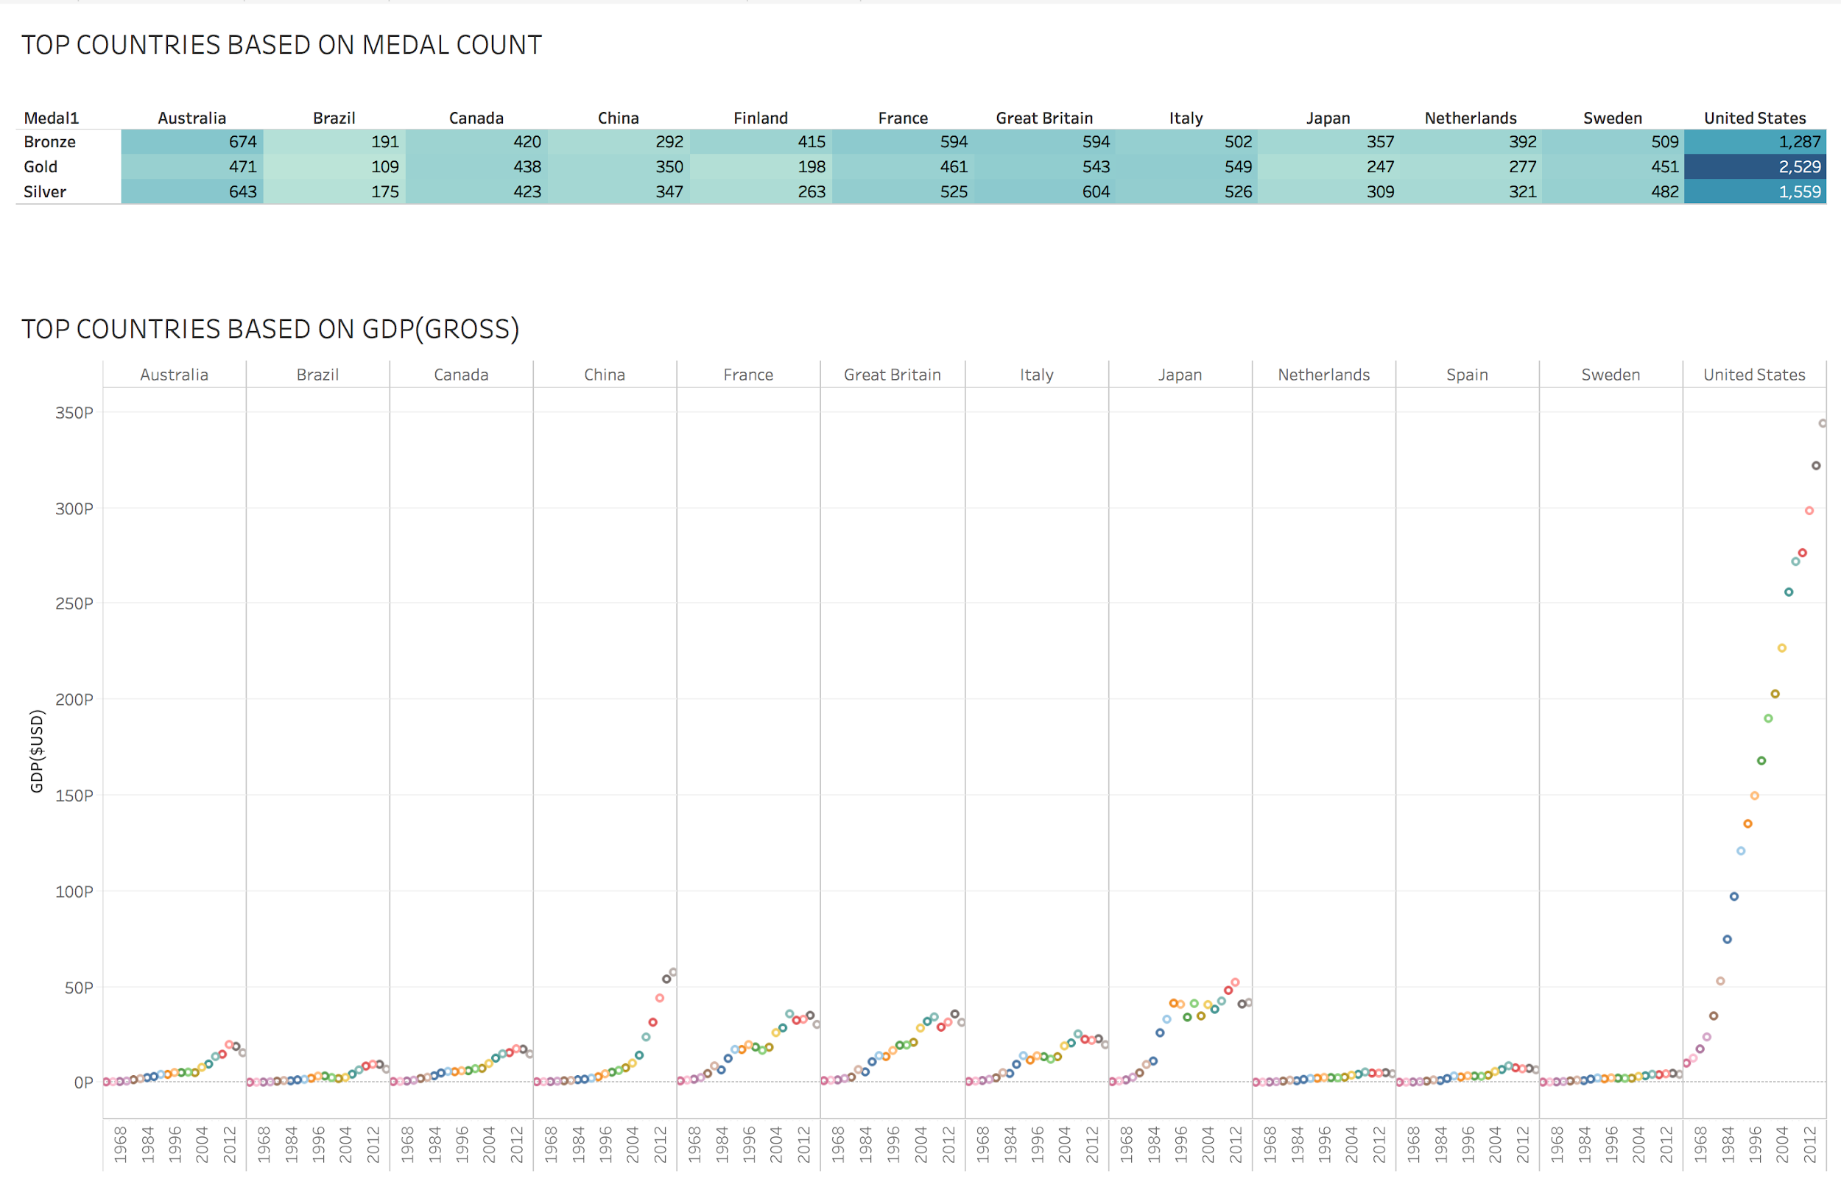
Task 1:
Relation between Nations’ GDP(Gross Domestic Product) and Medal Ranking
Notes:
20sec

Slide 4
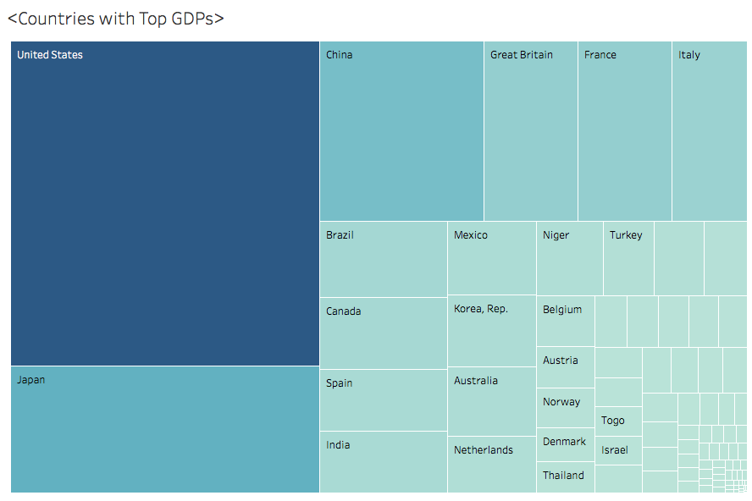
Task 1:
Relation between Nations’ GDP(Gross Domestic Product) and Medal Ranking
Implementation
Tableau Prep: clean and shape the data
Tableau: create visualization
Evaluation
Clear Indication of Two Variables: nation’s GDP, its corresponding medal achievements
Provision of Instinct Understanding
Provision of Clear Findings
Notes:
15sec

Slide 5
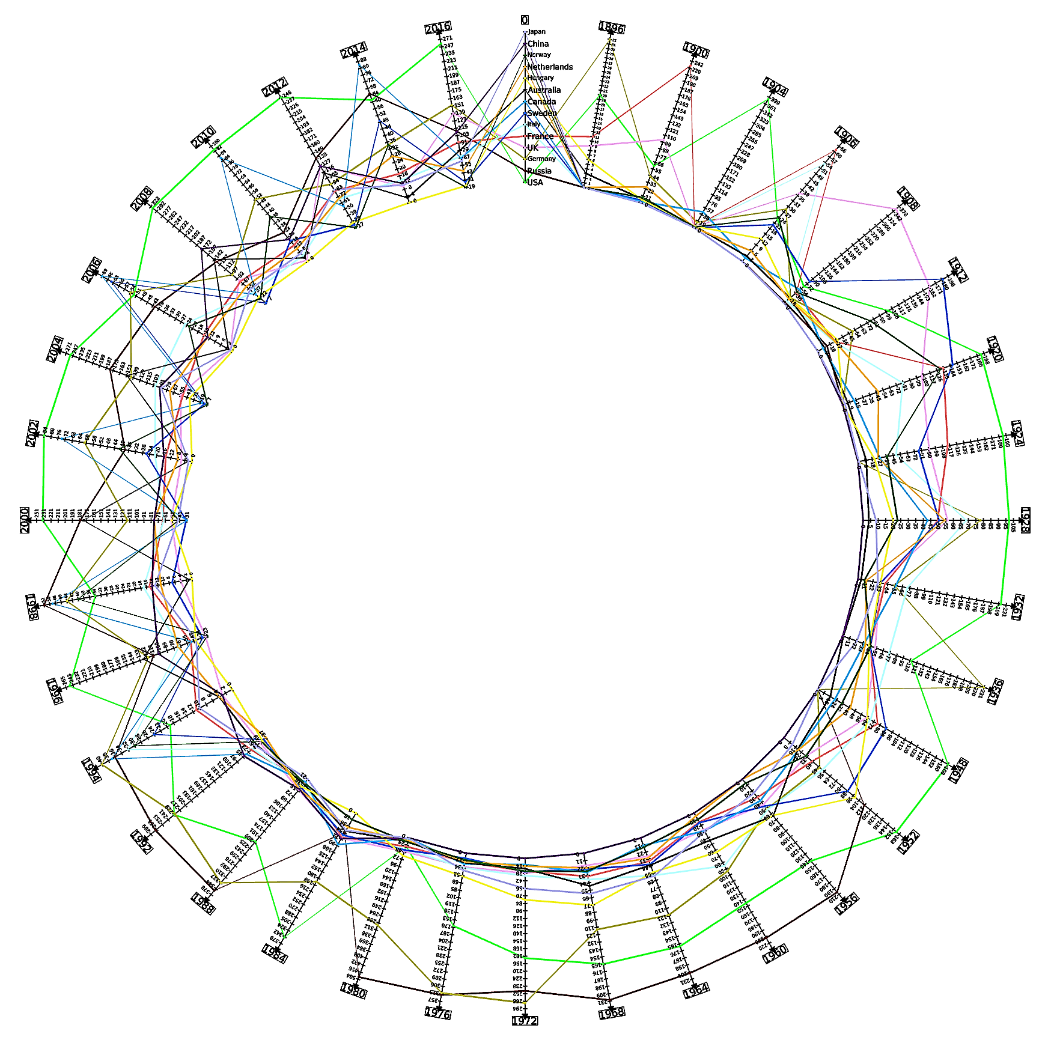
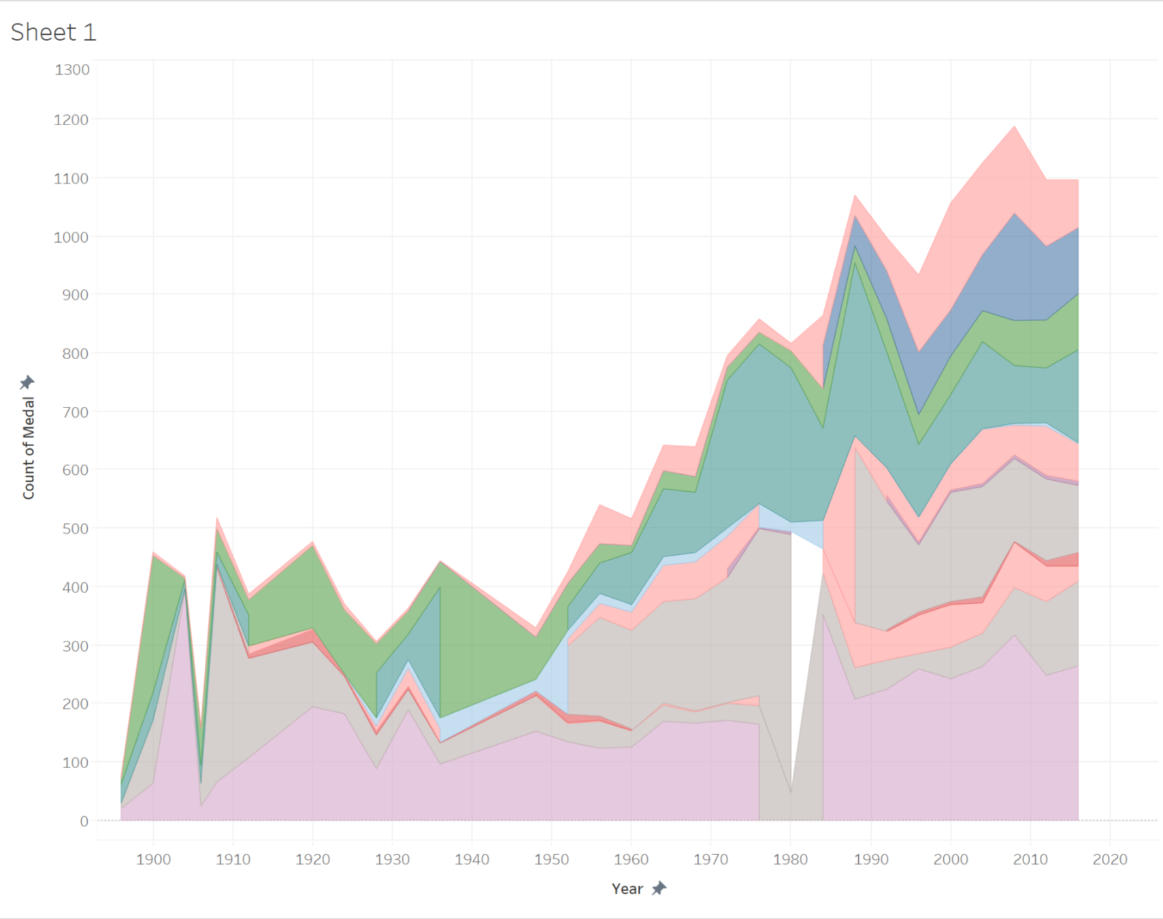
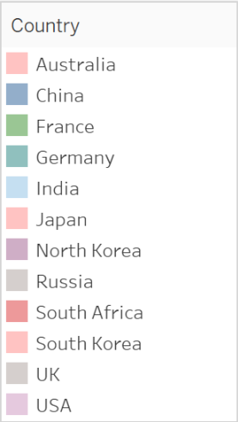
Task 2: Effect of world events on Olympics
Area Chart Continuous
Parallel Coordinates (Circular) Layout

Slide 6
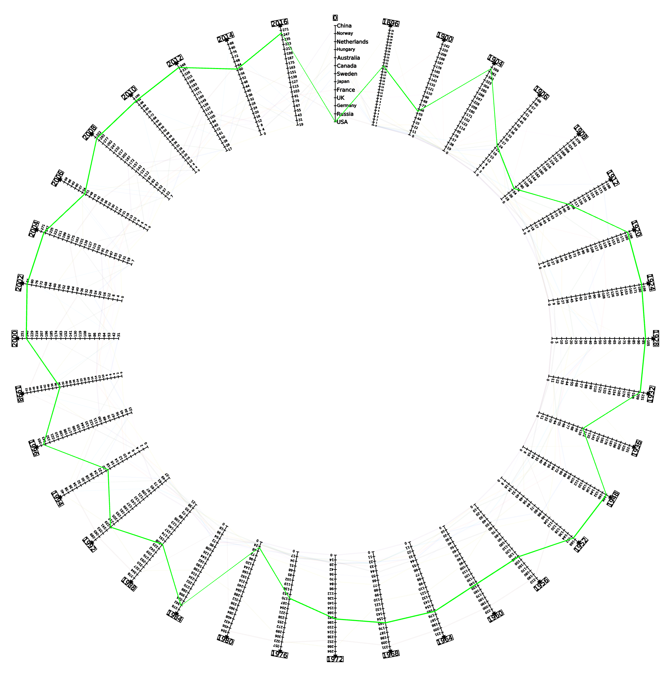
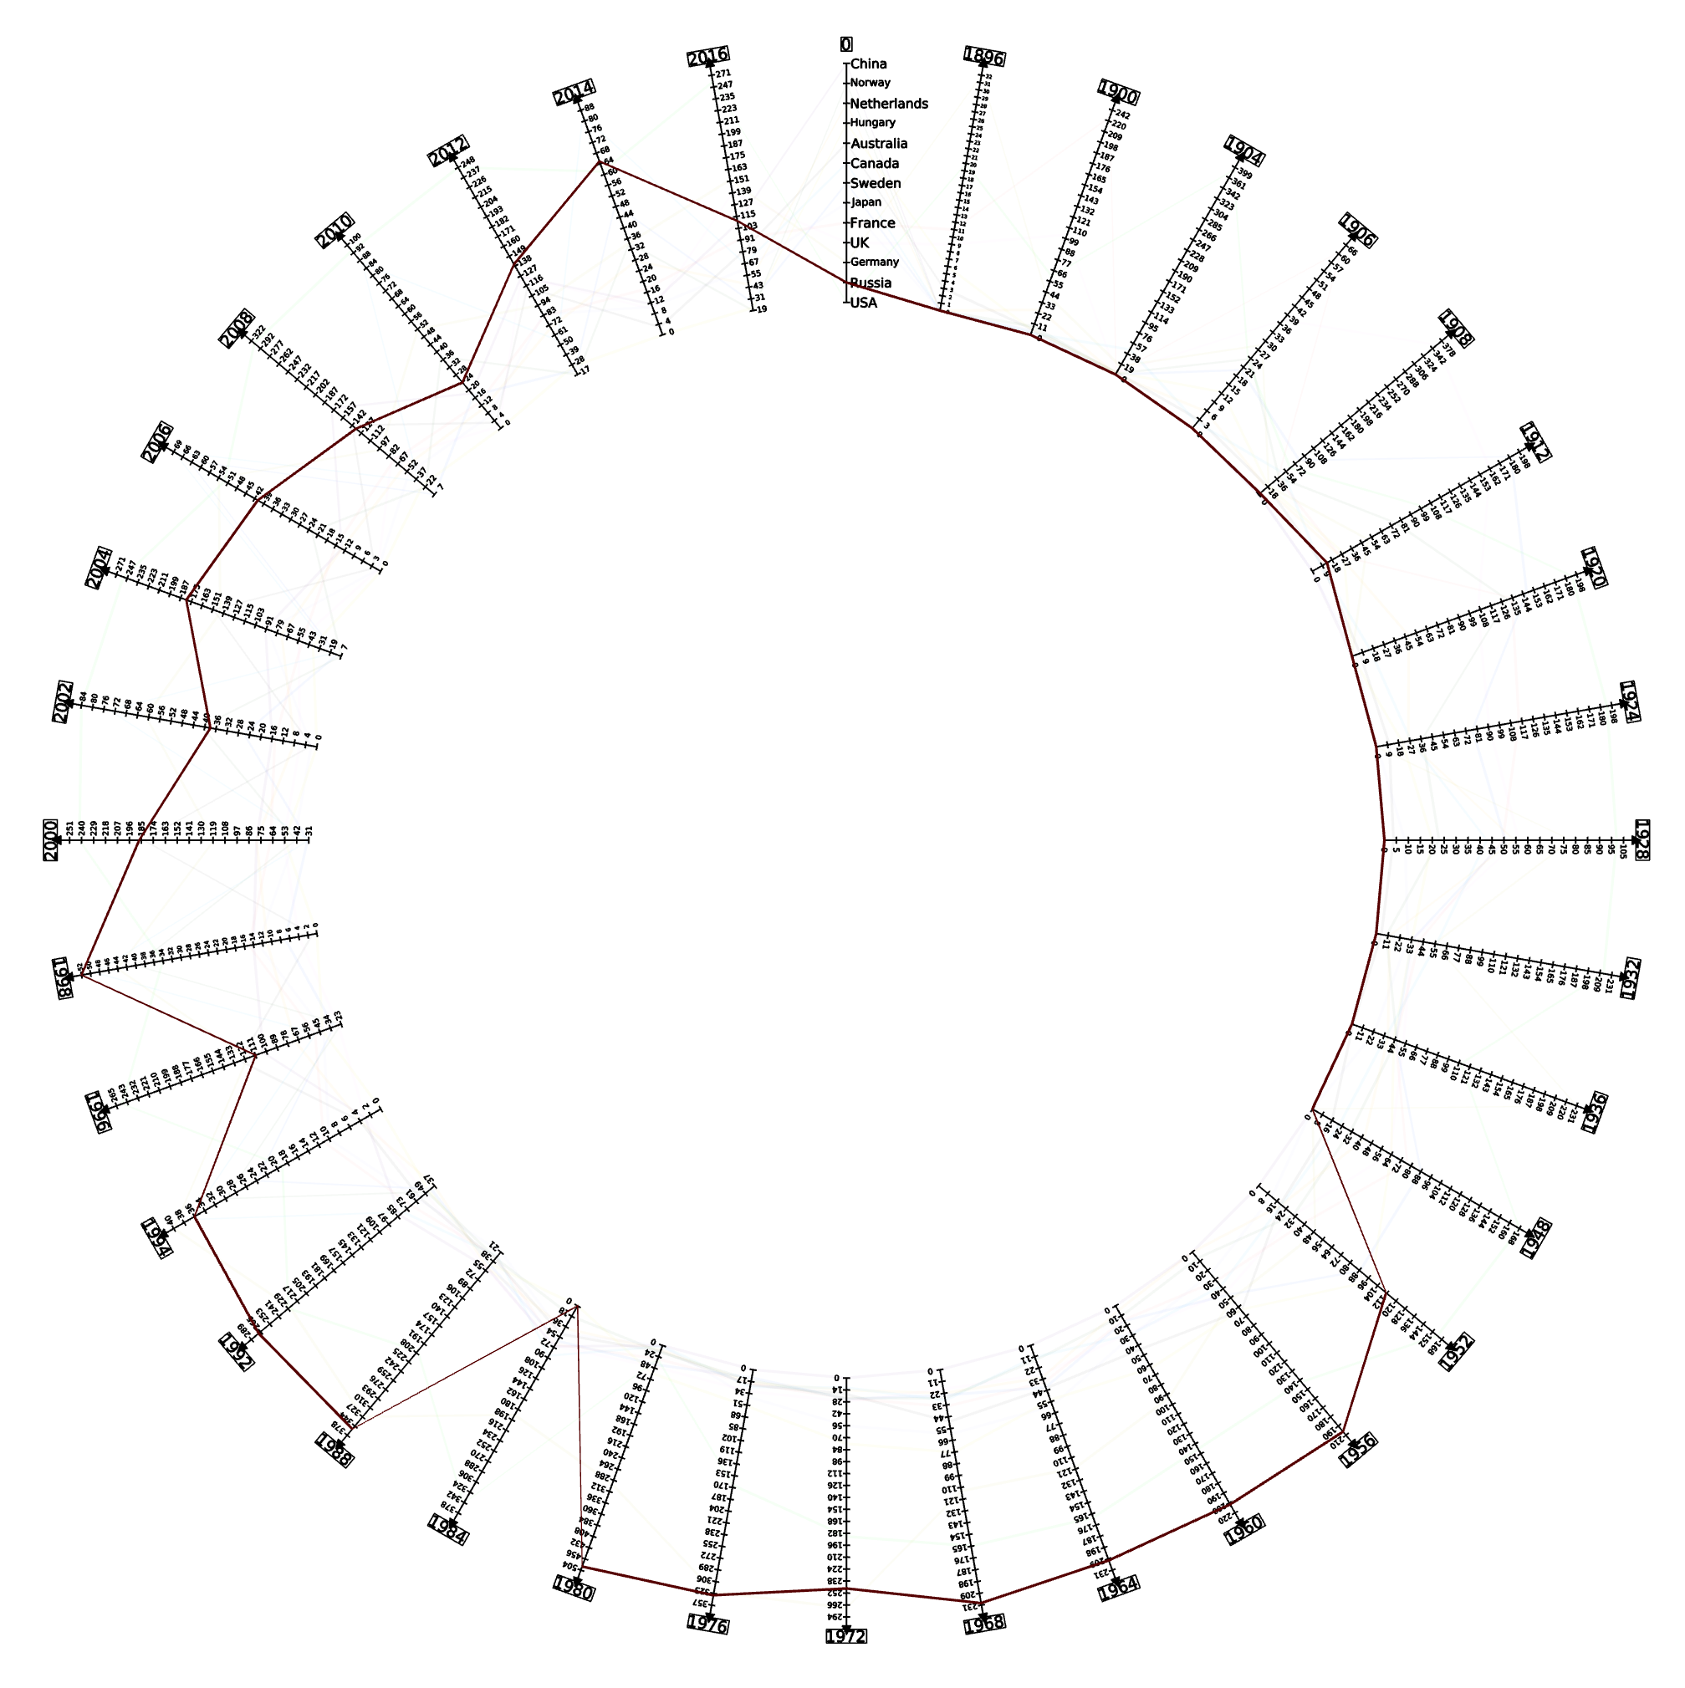
In 1980, USA boycotted Olympics due to cold war with USSR
Task 2: Contd.
USA
Implementation
Data Preprocessing: MS Excel
Software used: Tulip and Tableau
Layouts used: Parallel Coordinates (Circular layout) and Area Chart Continuous
Did not participated in olympics till 1952 as it considered Olympics as a propaganda tool for capitalism
Russia

Slide 7
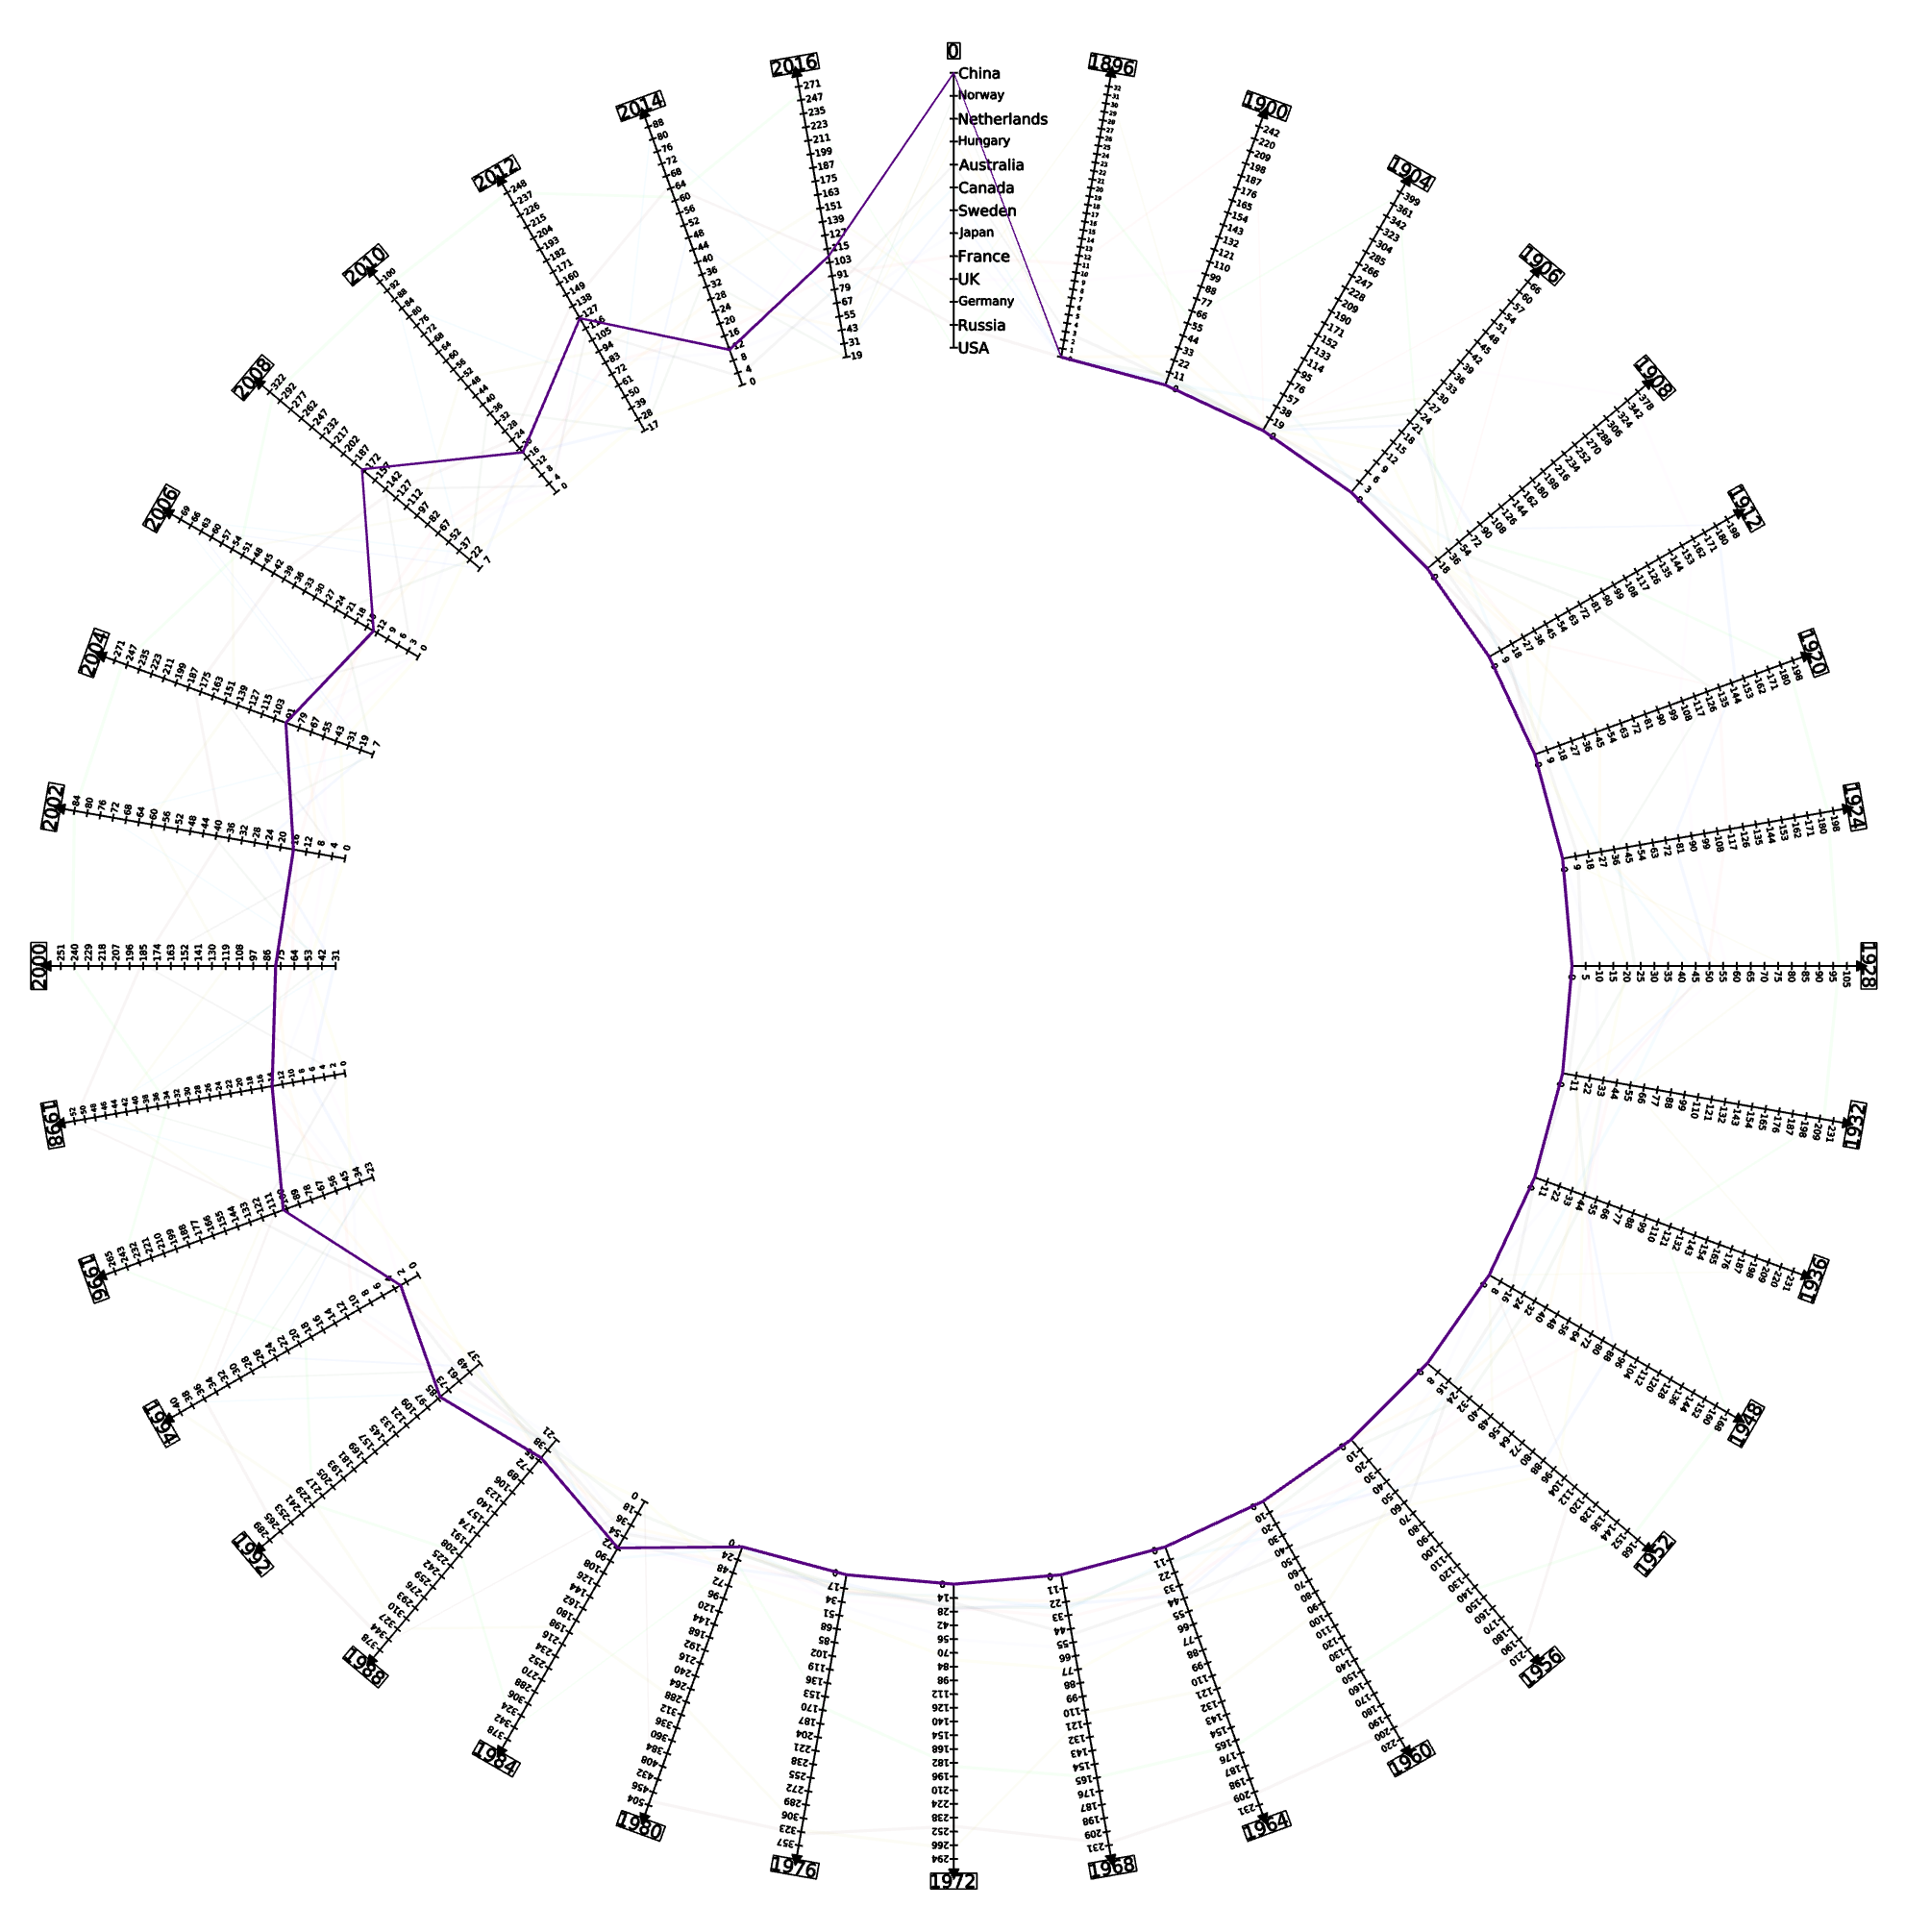
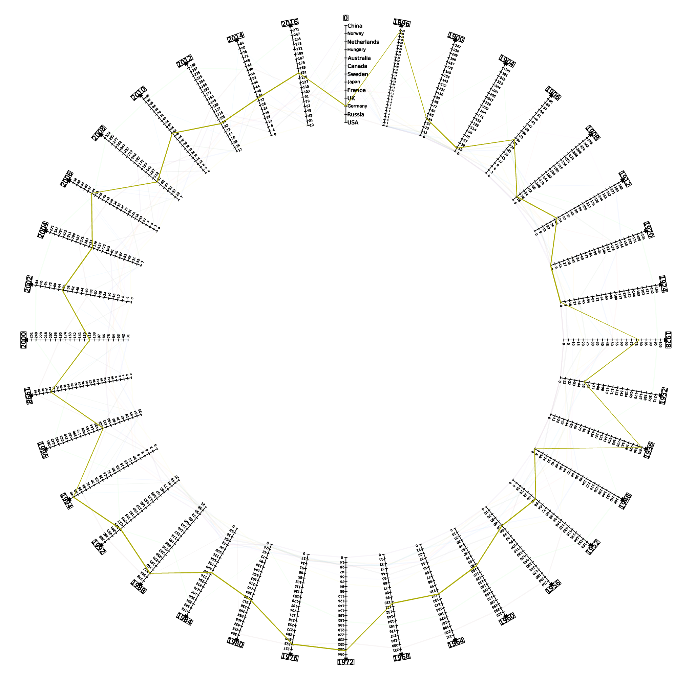
Did not participated in Olympics till 1984 because it was against the participation of Taiwan in Olympics
Task 2: Contd.
China
Evaluation
Correlation observed between geo-political phenomenons and the olympic performance.
Interesting outlier observations detected for major countries of the world.
Not invited in 1920, 1924 & 1948 Olympics due to world war event
Germany
Notes:
3min20sec

Slide 8
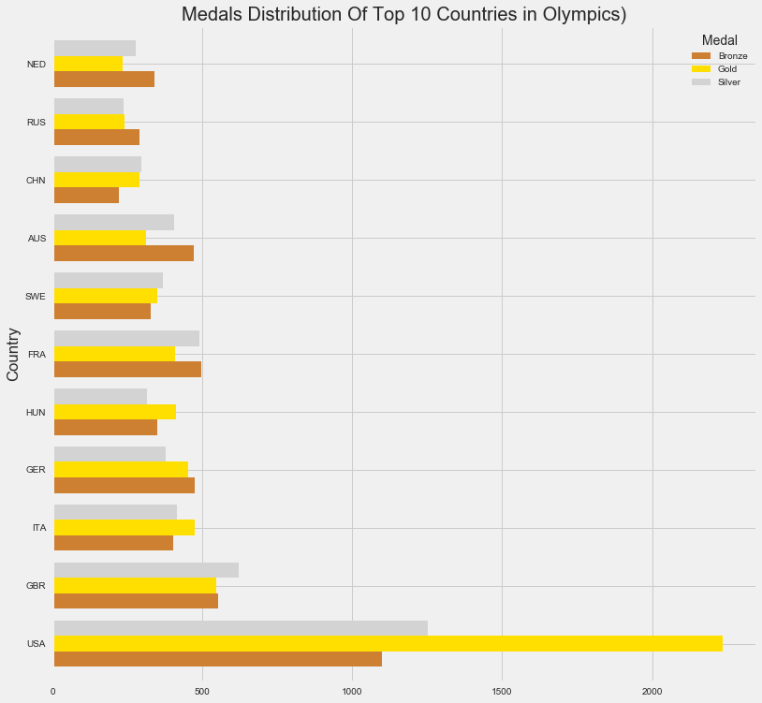
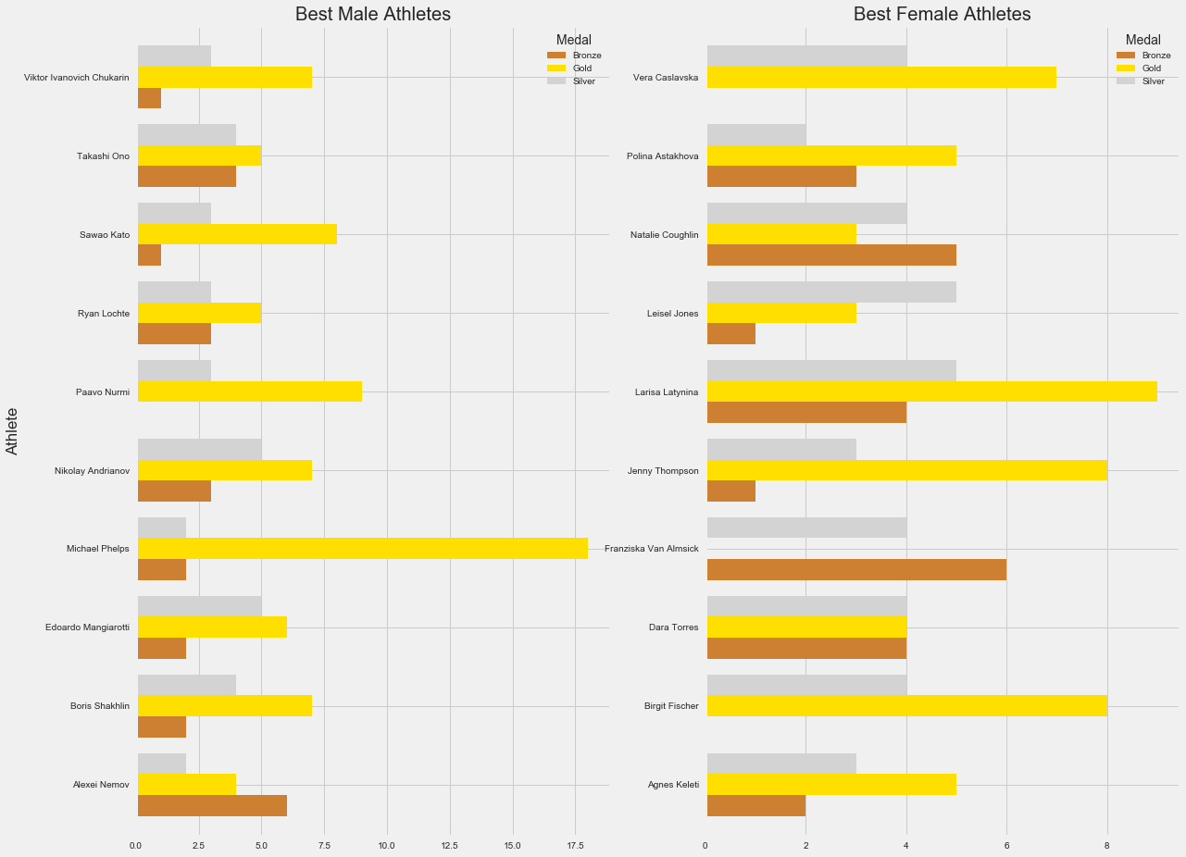
Task 3:
Identify dominant countries based on medals won
Notes:
4min40sec

Slide 9
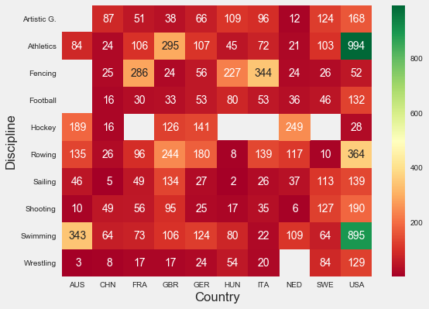
Task 3: Contd.
Identify dominant countries based on medals won
Implementation
Python: clean and shape the data
Python Plots: create visualization
Evaluation
Clearly shows the dominant countries in these sports.
Unexpectedly discovered weak projects in some countries.
Notes:
2min30sec

Slide 10
Progress and Planning
Data Cleaning and Preprocessing
Week 9
Creating and Configuring Visualization
Week 9-11
Producing Report
Week 11-12
Loading Data to Software
Week 9

Slide 11


